Slide 1
Dynamic Technical Indicators using a Multi Layer Perceptron
Yohaan Chokhany

Slide 2
Strategy
Objective
Methodology
Hypothesis
The goal of this strategy is to develop a deep learning model using a Multi-Layer Perceptron (MLP) to predict stock market movements based on technical indicators.
Yahoo Finance API
Feature Engineering
SMA
EMA
Bollinger Bands
and more..
Multi-Layer Perceptron
Buy, Sell, Hold
A combination of a series of technical indicators can together be outperformed by a neural network dynamically analysing all of them.
Hassan Khoury ©

Slide 3
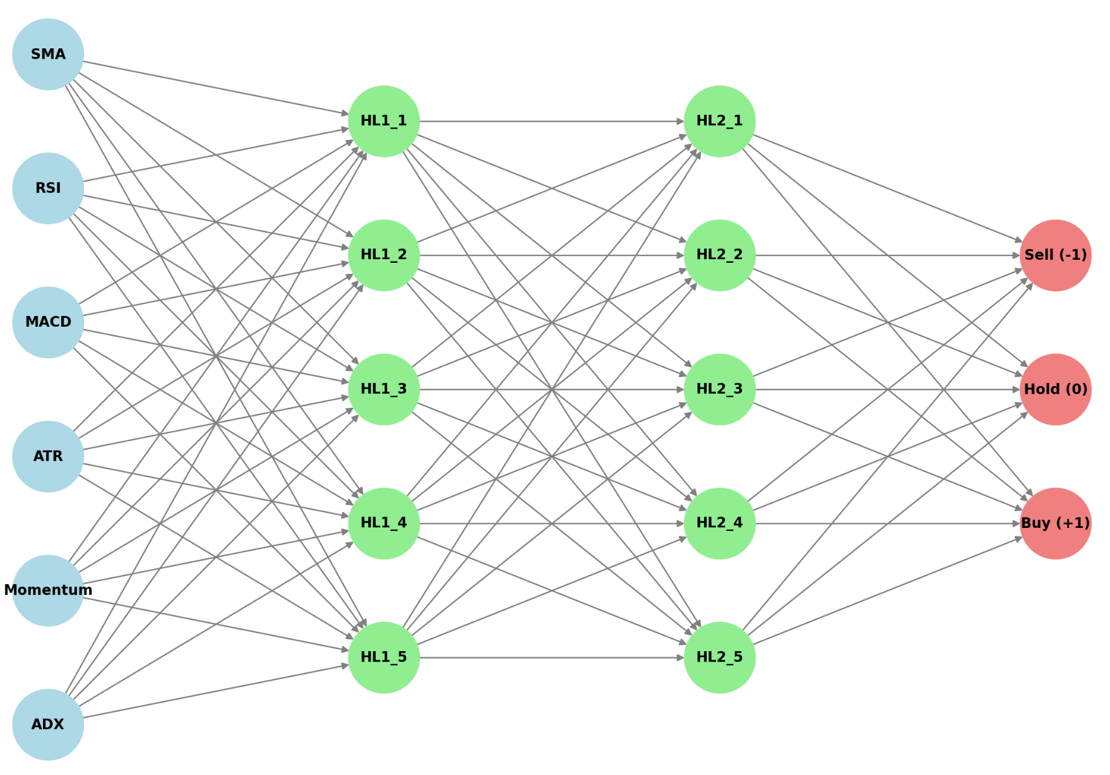
Model Architecture

Slide 4
Conclusion
Outperformed buy-and-hold strategy by 30%
Outperformed dynamic indicators by 10%

